Slide 1

Discovering Crypto Market Regimes with Spark
CS 532
Systems for Data Science
Final Project Presentation
Brandon Byrne ,
Vishal Garimella,
Sravanthi Machcha,
Yuxin Zhang
Github Link:
https://github.com/umass-byrneb/CS532-Group_Project

Slide 2
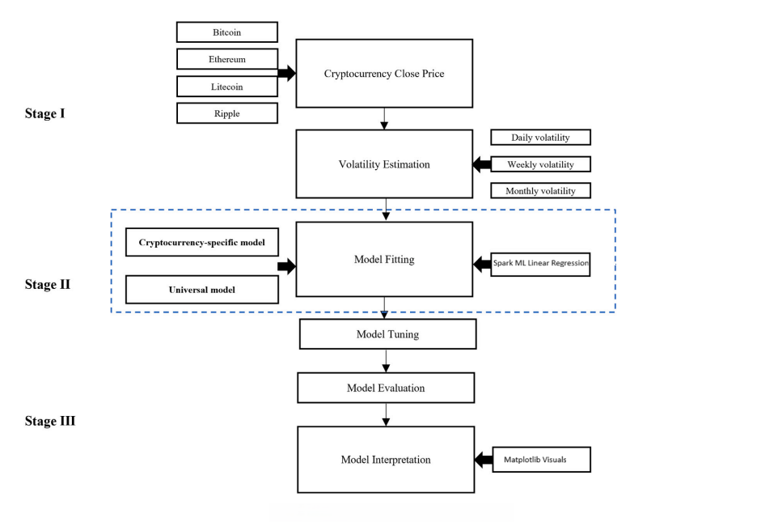
Overall Spark Pipeline Architecture
Adapted Source : https://www.pure.ed.ac.uk/ws/portalfiles/portal/381945597/WangEtal2023IRFAMachineLearningApproaches.pdf

Slide 3
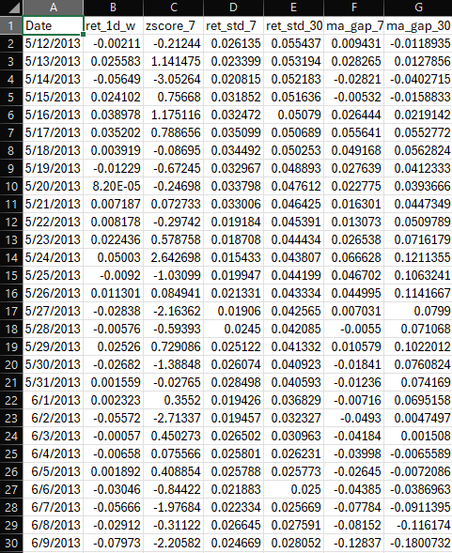
Data Ingestion & Feature Engineering (MS1–MS3)
Input: daily per-symbol prices/returns → features_ml_daily parquet
Features:
- 1-Day Return Percentage,
- Rolling Volatility,
- Z-scores,
- Moving-Average Gaps.
Design choice: narrow, numeric schema suitable for Spark ML
Trade-off: richer features vs. pipeline complexity and runtime
Daily Bitcoin(Symbol: BTC) Returns

Slide 4
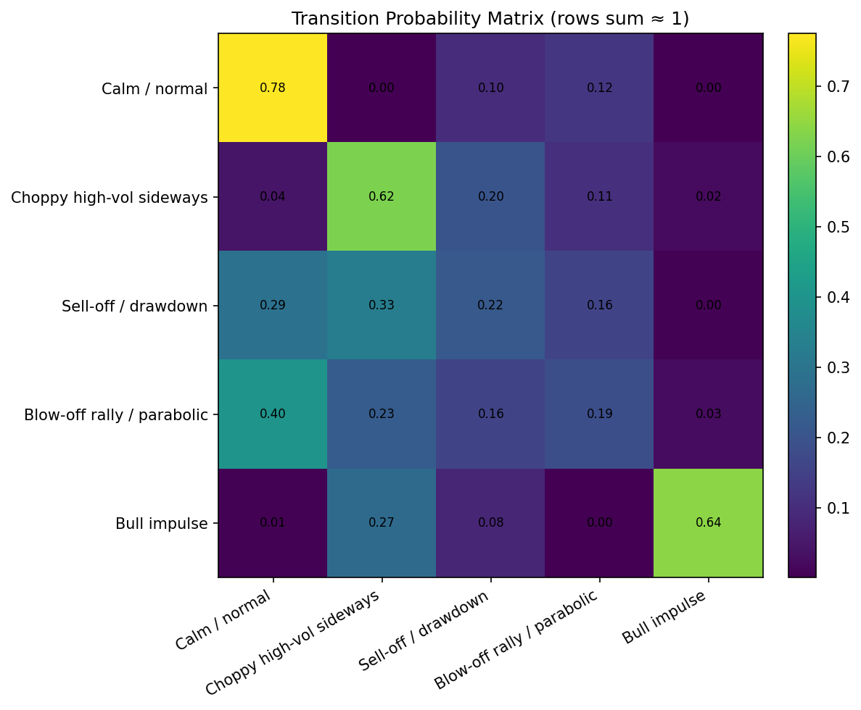
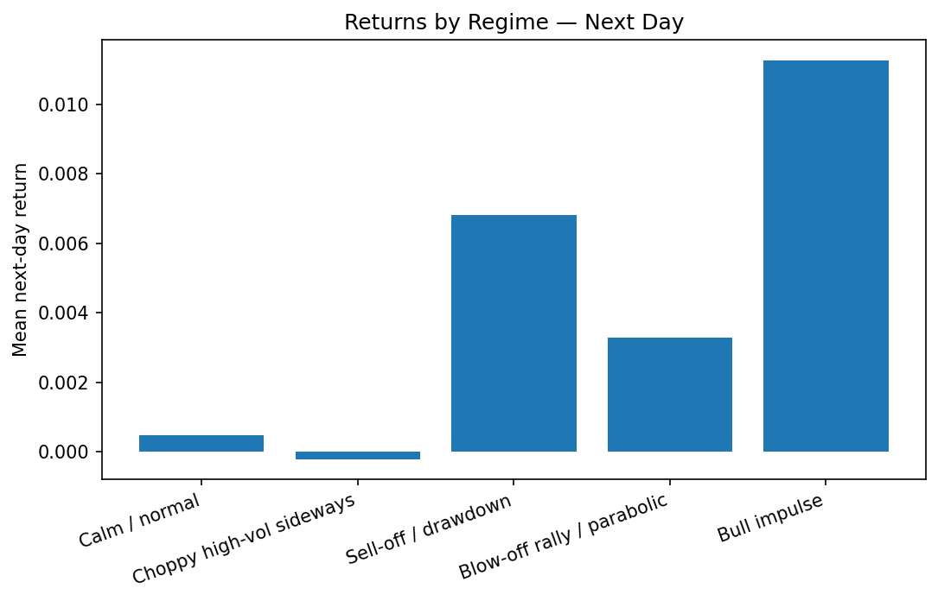
Spark Job Structure and Caching (MS4)
Step 1: Input Validation & Manifest
Step 2: Transition Stats & Dwell Times
Step 3: Regime Returns
Step 4: Transition Returns
Step 5: BTC Regime Returns by Symbol
Step 6: Cluster Characterization
Step 7: Predictive Gauge

Slide 5
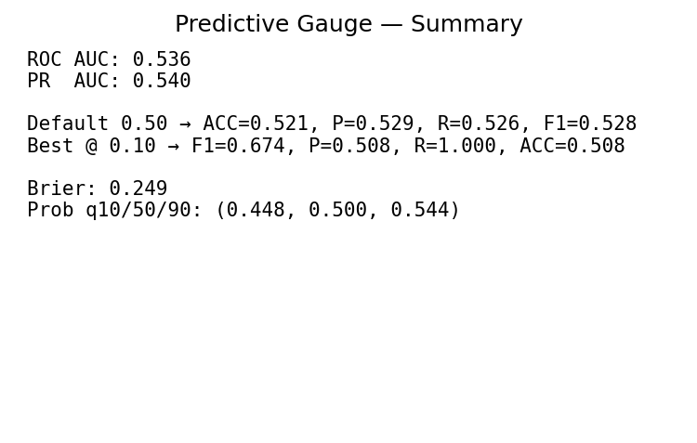
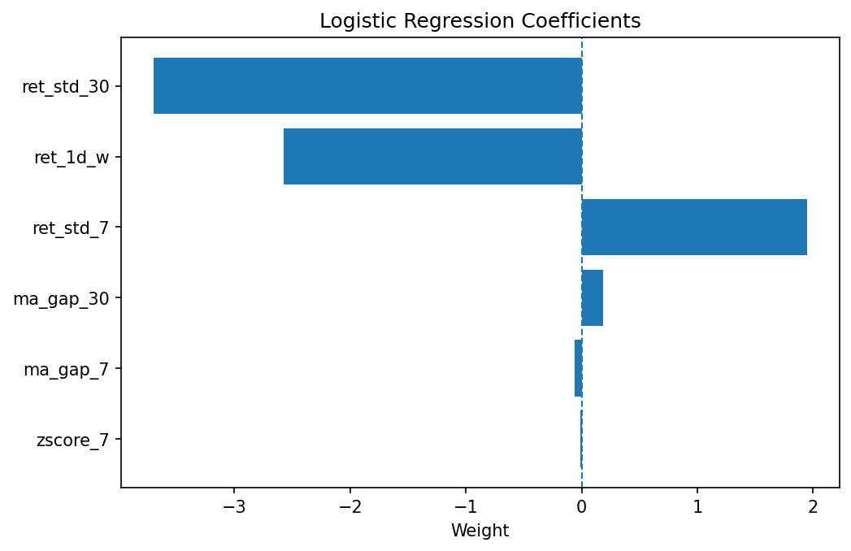
Predictive Gauge & ML Integration(MS4 Step 7)
Step 7 joins features + forward returns per symbol
- Simple predict sign, not magnitude
Features = subset of numeric signals
Model= Spark LogisticRegression with optional class weighting
Outcome= ROC AUC ≈ 0.54–0.56,
PR AUC ≈ 0.56
Weak but non-trivial signal

Slide 6
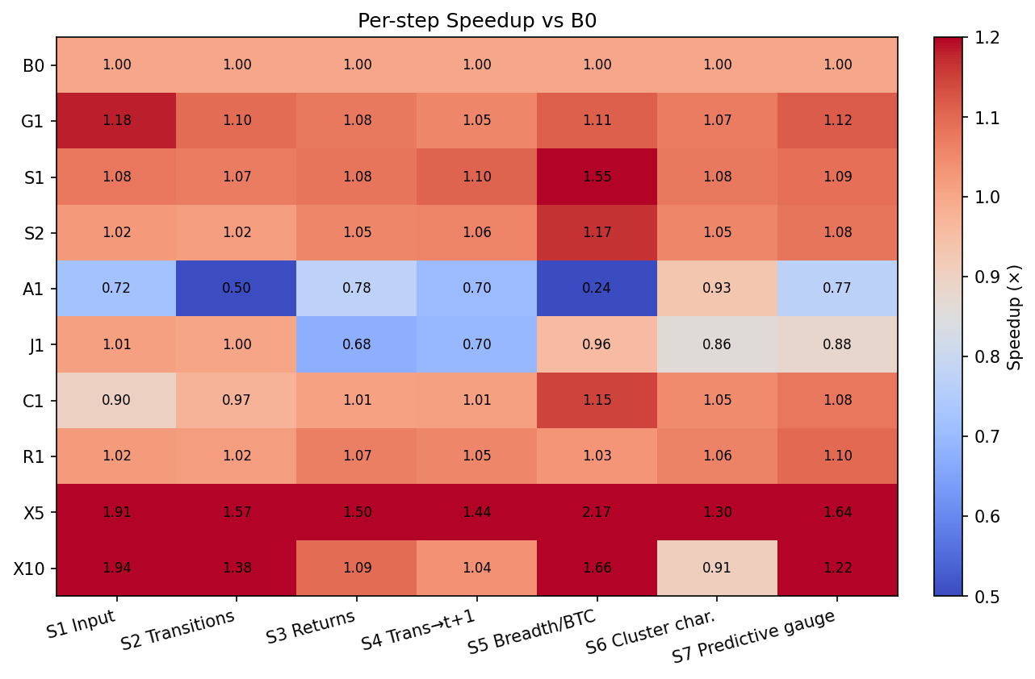
Benchmark Harness: Experiments & Metrics(MS5)
MS5_benchmark runs ms4_analysis under varied Spark configs
B0= Baseline. local[*], AQE=ON, shuffle.partitions=200, broadcast=10MB, Kryo, cache=ON, codegen=ON
P1/P2=Cores=local[1]/[4]=Quantify Parallel Speedup
S1/S2= shuffle.partitions=32/800=Shows overhead when too many tiny shuffle tasks
A1=AQE OFF=Quantify Adaptive Query Exec benefit
J1=Broadcast join OFF=Forces shuffle join; expect slower joins
C1=No caching
R1=Serializer=Kryo vs Java serializer impact on shuffles
G1=Codegen OFF=Disables whole-stage codegen
X5/X10=Scale Factor=Makes differences visible; checks that caching/storage levels prevent OOM/spill disaster.

Slide 7
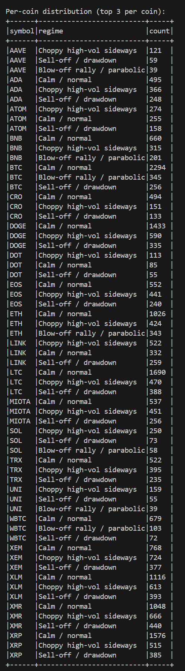
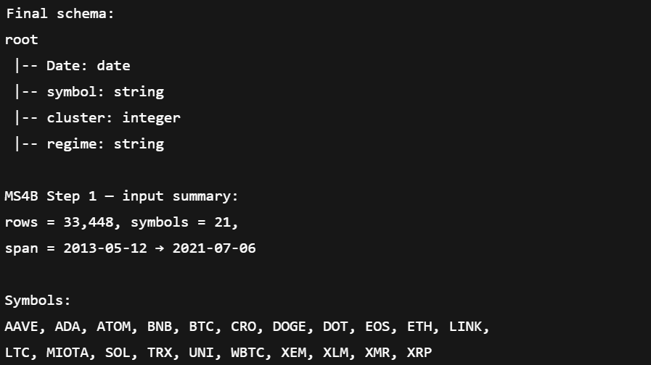
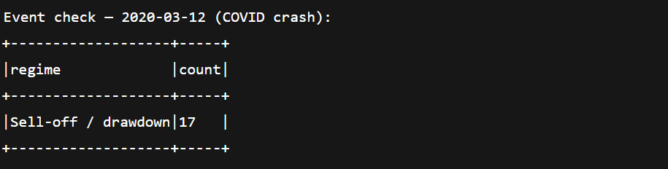
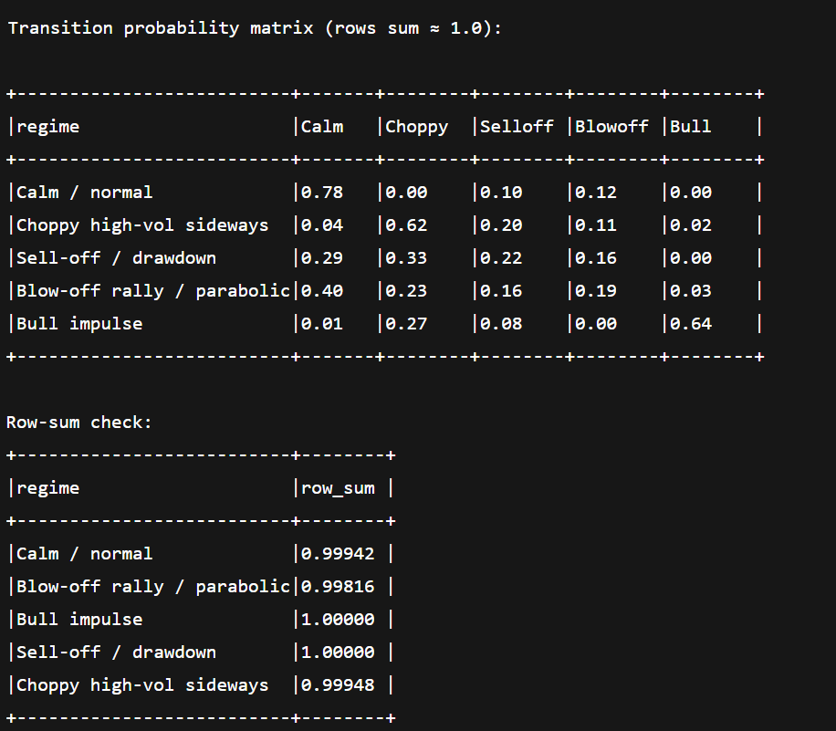
Testing: Data Integrity & Sanity Checks
Schema & span checks in Step 1:
- Print schema, min/max Date, row count, symbol
Regime consistency:
- Per-regime counts, per-coin top regimes, special day check (e.g., 2020-03-12)
Transition / dwell validation:
- Check row-sum of transition probabilities ≈ 1.0
Breadth validation:
- Per-date regime counts sum to total (no missing assignments)

Slide 8
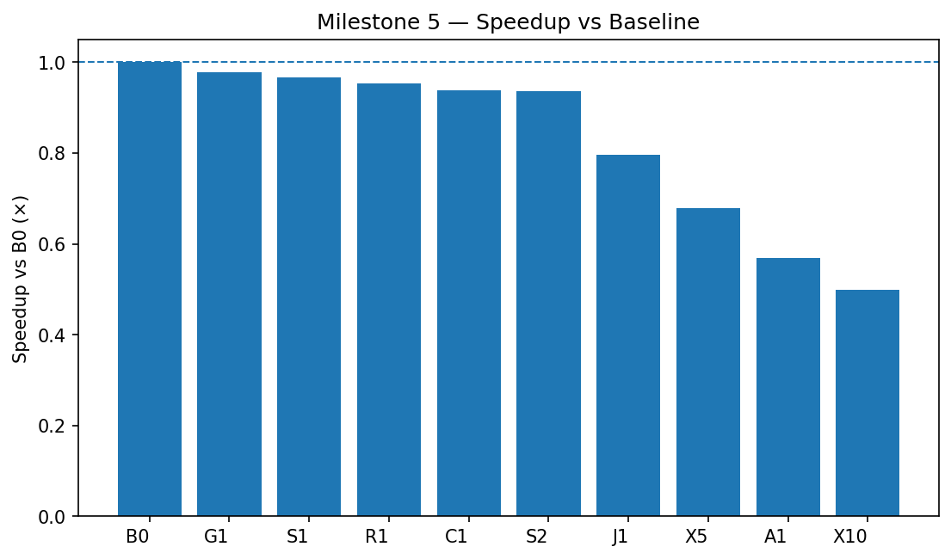
Testing: Data Integrity & Sanity Checks
Dry-run mode prints planned experiments and Spark configs without executing
Verification each experiment: Writes metrics.json, summary.csv row, and _timings.jsonl
Cross-check MS5 vs MS4: Per-step times in summary_agg.csv match MS4 _timings.jsonl values
Scaling tests X5/X10:Ensure pipeline still completes, and wall time grows as expected (no crash or OOM)

Slide 9
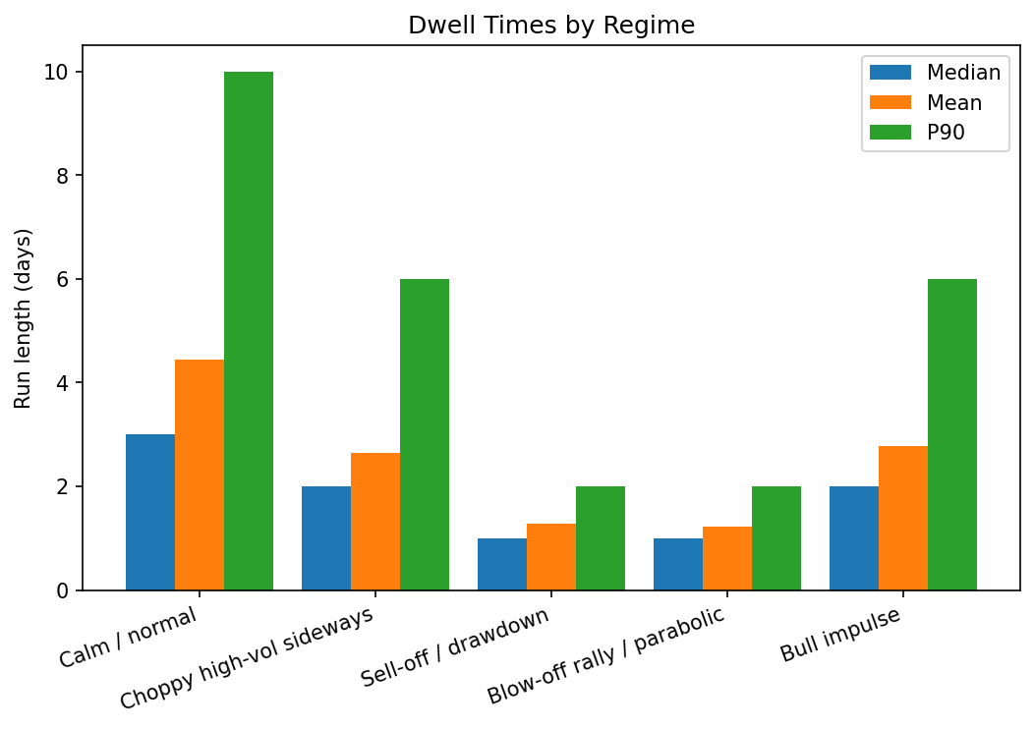

Experimental Results: Regime Dynamics & Market Behavior
Dwell-time bars:
- Median and mean run lengths differ by regime → some regimes are short “spikes”
- Others are slow regimes
Transition matrix heatmap:
- High diagonal → regimes tend to persist;
- Certain regime pairs transition more often

Slide 10
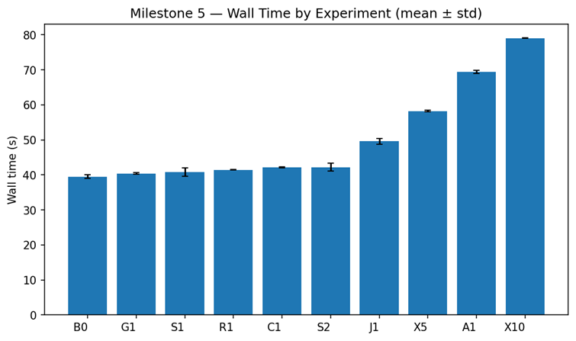
Experimental Results: System Performance & Predictive Gauge
Wall-time bar chart:
- Most configs near baseline;
- AQE OFF (A1) much slower
- AQE and broadcast joins clearly matter for join-heavy steps
- Step 5 and the later ML-related steps drive most differences
Gauge performance:
- Better than chance but weak predictive power
Open questions:
- How would results change with a deeper model or more features?
- How do these Spark settings behave under true cluster load?

Slide 11
Possible Improvements
Explore different partitioning schemes for Parquet (e.g., partition by Date or symbol subsets)
Move from single local node to a multi-node Spark cluster for more realistic scaling
Add more detailed instrumentation: per-stage Spark UI exports, shuffle read/write bytes, skew diagnostics
Replace some Python logic with Spark SQL views for easier optimization by the Catalyst planner
Explore different partitioning schemes for Parquet (e.g., partition by Date or symbol subsets)
Extend the benchmark suite with long-running workloads (e.g., additional windows, more features, or deeper models)

Slide 12
Goals
Goal 1 – Build an end-to-end Spark pipeline:
- Status: Achieved — ingestion, clustering, regime labeling, and analysis all automated
Goal 2 – Characterize regimes & market structure:
- Status: Achieved — transition/dwell stats, regime returns, Time Metrics
Goal 3 – Add a simple predictive gauge:
  - Status: Achieved — model runs and metrics are computed, but predictive power is low
Goal 4 – Study system-level trade-offs:
- Status: Achieved — benchmark harness, multiple Spark configs, per-step timings
Goal 5 – Make results reusable & report-ready:
- Status: Achieved — figure generator, artifact directories, and runnable scripts

